Slide 1
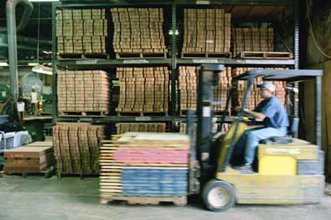



IBM solution overview 16/12/02
Accelerate speed to market
Maximize inventory turn
Minimize supply chain costs

Slide 2














How can software support business?
Retailer HQ
Customer
Channels
Distribution
Supply Chain
Provide insight into Consumer Demand
Optimise Demand Levers (Price, Promotions, Assortment, Space)
CREATE
MANAGE
FULFILL
Notes:
Retek’s Mission is to Help the Retail Industry Create, Manage and Fulfill Consumer Demand
Create :
Key is to use customer insight in all demand and supply decisions.
Retek does this via Customer Revenue Optimization and using Retek Demand Forecasting to predict consumer demand which is then leveraged in all downstream demand and supply decisions
Example CRO : Simon Delivers who identified their most profitable customer segment and then were able to create marketing events that targeted growing the revenue from that segment
RDF : GAP forecasting inseason to drive item life cycle plans
Optimize Demand Levers to impact consumer behavior and drive up business metrics.
Example - price optimization in item life cycle plans at GAP
- RO for assortment rationalization
- Assortment to space optimization (currently in development)

Slide 3
How can software support business?
Retailer HQ
Customer
Channels
Distribution
Supply Chain
Provide insight into Consumer Demand
Optimise Demand Levers (Price, Promotions, Assortment, Space)
CREATE
MANAGE
FULFILL
Enable demand driven Supply Chain operations
Provide Optimisation of Supply Chain decisions
Notes:
Retek’s Mission is to Help the Retail Industry Create, Manage and Fulfill Consumer Demand
Create :
Key is to use customer insight in all demand and supply decisions.
Retek does this via Customer Revenue Optimization and using Retek Demand Forecasting to predict consumer demand which is then leveraged in all downstream demand and supply decisions
Example CRO : Simon Delivers who identified their most profitable customer segment and then were able to create marketing events that targeted growing the revenue from that segment
RDF : GAP forecasting inseason to drive item life cycle plans
Optimize Demand Levers to impact consumer behavior and drive up business metrics.
Example - price optimization in item life cycle plans at GAP
- RO for assortment rationalization
- Assortment to space optimization (currently in development)

Slide 4
How can software support business?
Retailer HQ
Customer
Channels
Distribution
Supply Chain
Provide insight into Consumer Demand
Optimise Demand Levers (Price, Promotions, Assortment, Space)
CREATE
MANAGE
FULFILL
Enable demand driven Supply Chain operations
Provide Optimisation of Supply Chain decisions
Provide scaleable, flexible infrastructure for business
Offer efficient, standardised platform for operation
Notes:
Retek’s Mission is to Help the Retail Industry Create, Manage and Fulfill Consumer Demand
Create :
Key is to use customer insight in all demand and supply decisions.
Retek does this via Customer Revenue Optimization and using Retek Demand Forecasting to predict consumer demand which is then leveraged in all downstream demand and supply decisions
Example CRO : Simon Delivers who identified their most profitable customer segment and then were able to create marketing events that targeted growing the revenue from that segment
RDF : GAP forecasting inseason to drive item life cycle plans
Optimize Demand Levers to impact consumer behavior and drive up business metrics.
Example - price optimization in item life cycle plans at GAP
- RO for assortment rationalization
- Assortment to space optimization (currently in development)

Slide 5
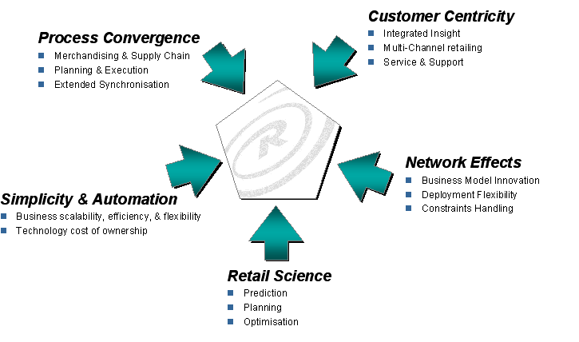
Software Philosophy
Retail applications and business processes are in transition…

Slide 6


Software Philosophy
Advanced Forecasting, Modelling and Optimisation Solutions
High performance supporting optimal decision making
Advanced Retail Planning & Optimisation Solutions
High Performance Retail Execution Solutions
Transaction Processing and Business Operation Solutions
High performance supporting best business operation

Slide 7
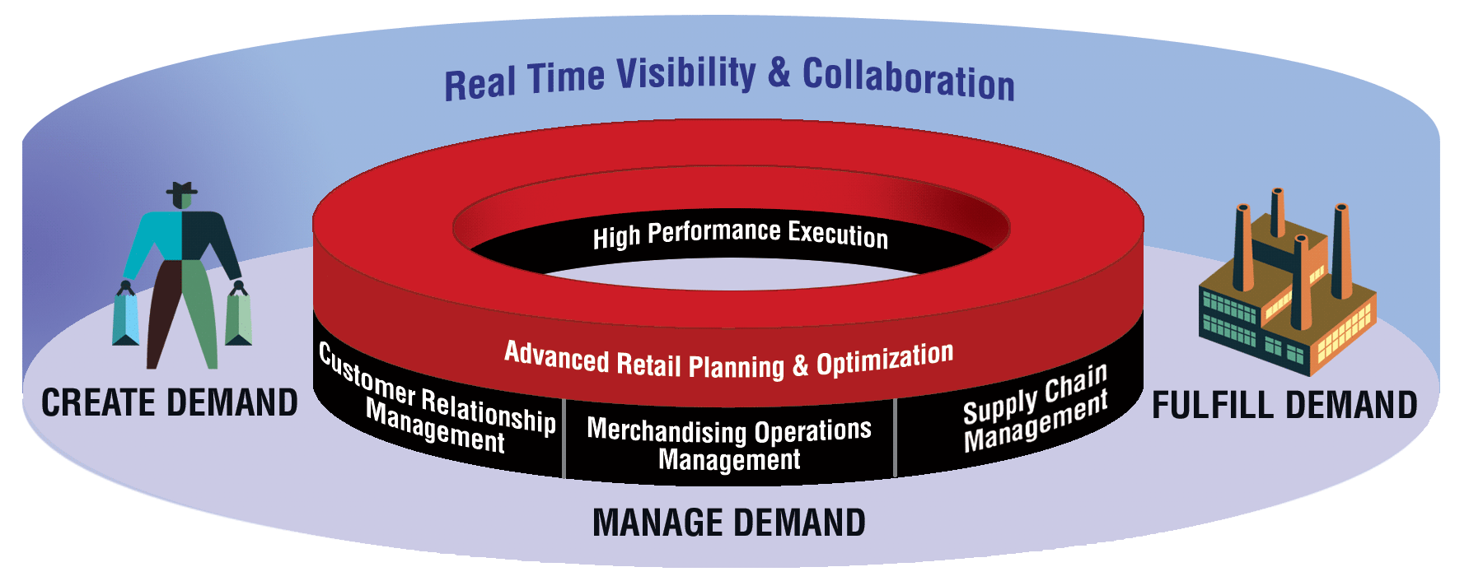
Retek Solutions
Retek Advanced Retail Planning & Optimisation


Consumer Demand Forecasting
Assortment & Space Optimisation


Company, Range & Space Planning
Price Strategy Optimisation


Advanced Replenishment & Allocation
Customer Revenue Optimisation
Maximise Market Opportunity
Optimise Flow of Supply
Retek Customer Relationship Management
Lowest Cost Operations Highest Asset Utilisation
Retek Supply Chain Management

Point of Service
Retek Merchandising Operations Management

Warehouse Management

Store Operations Solutions

Collaborative Global Logistics


Integrated Merchandising Operations
Customer Order Management

Collaborative Design & Source


Performance Analysis
Brickstream

Exception Management & Workflow

Retek Integration Bus

Slide 8











Why Retek ?
“The Retail Info Systems News annual Leaderboard study of the top 50 software companies serving retail, issued this week, names Retek Inc. (NASDAQ: RETK) as the number-one retail software vendor” RIS.
Proven in Retail
Scalable solutions for retail data volume
Predictive Science to enable smarter and faster decision making
Technology and architecture to support the infrastructure of the world’s largest retailers
Fast Return on Investment
Importance & Value
Metrics:
WH Smith
Notes:
Why Retek ? Retek is stronger in the following 5 key selection criteria then any other software vendor in retail.

Slide 9
Proven in Retail
“Based on our analysis Retek references were in the 90th percentile of overall satisfaction” Chuck Crovitz EVP GAP Inc.
Risk Mitigation - Proven
Functionality is Easy vs. Retail Scalability
Robust Retail Best Practices
  Scientific Retailing
Importance & Value
Metrics:
Consumer Sales
2001 – Retail infrastructure for over $450 B in retail sales
Retek Customers
180 International retailers
6 plus new clients per quarter
Go Lives
2000 21 go lives
2001 26 go lives
Notes:
These are just a sampling of our many customers…(highlight customers who are similar to the customer/prospect either in terms of products they sell, business model, SKU/store combinations, revenues, etc.)
The following is a list of customers included on slide and the licenses they have (as of 1/00) – they are at various stages of implementation.
Abercombie & Fitch: RDM Aldo: RDF, RDM, RMS, ARI, RDW, RTM, Financial API’s
Ames: RMS, ARI, RDW, SKU Ann Taylor: RMS, ARI, RDF, RTM, RDM, Financial API’s
Brooks Bros: RMS, ARI, RDW, RDF, Store Ops, Financial API’s
Chapters: RMS
The Container Store: RMS
Cracker Barrel: RMS
Despar: RMS, ARI, RDW, RDF, RDM
Eckerd: RMS, ARI, Store Ops, Sales Audit, RDM, RDF
Edcon (formerly Edgars): RMS, ARI, RDW, RDF, Invoice matching, RTM, Financial API’s, RDM
El Palacio: RDW, RMS, ARI
Family dollar: RMS, ARI, RDW, RDF, RTM
Fingerhut: RMS, ARI, RDF, RTM, RDW, Invoice Matching
FNAC: RMS, ARI, RDF, RDW, RDW, RDM, Sales Audit
Fogdog: RMS
Fosseys: RMS
Foster & Gallagher: RDM
Fruit of the Loom: SKU Plan
Future Shop: RMS, ARI, RDW, RDF, RDM
Gander Mountain: RMS, ARI, RDW, RDF, RDM, Invoice Matching
Giorgio Armani: RMS, ARI, Store Ops, Invoice matching, RTM, RDW
Hallmark: RMS
Home Shopping Network: RMS, ARI, RDW
HomeBase: RMS, ARI, RTM, RDF, RDW, Sales Audit, Invoice matching, RDM
Hudson’s Bay: RMS, ARI
Ingram: RMS, ARI, RDF, RDW Internet Shopping Network: RMS, ARI, RDW, Financial API’s
Kohl’s: RMS, ARI, RTM, RDM LL Bean: RMS, ARI, RDW, RDF, RTM
Lancome: RDF Lids: RMS, ARI, RDW, RDF
Littlewoods: RMS, ARI, RTM, RDW, WebTrack, RDF, RCS
NTUC Fairprice: RMS
Nike Japan: RMS, RDW Northwest Co: RMS, DMS
P.T. Matahari: RMS Pamida: RMS, ARI, RDF, RDW, Financial API’s, Sales Audit
Payless Cashways: RMS, ARI, RDW, RDF, Invoice Match, RTM
Playtex: RDF Reitmans: RMS, ARI, RTM, RDW
Sears Canada: RMS (stock ledger only), RDM
Selfridges: RMS ShopKo: RMS
Starbucks: SkuPlan Syms: RMS, ARI, RDW, RDM, Invoice Match, Sales Audit
Talbots: RDW, ARI Tosco (Circle K): RMS, ARI, RDW,
Wet Seal: RMS, ARI, RDW, Sales Audit, Invoice Match
Zale: RMS

Slide 10



Unprecedented Scalability
"The Retek solution offers incredible functionality and integration. We are excited to uncover how this will help us better work with large volumes of data and improve forecast accuracy.“ Ken Harris CIO, Gap Inc
Functionality is Easy vs. Scalability
Value is in the Detail
  Sku x Store demand and inventory management
Importance & Value
Metrics: Scalability Benchmark
119 M SKU X Store forecast 82 minutes
40,000 Store replenishment 180 minutes
2,800 Concurrent infrastructure users
20,000 POS trickle polled transactions from 450 stores in less than 10 minutes
40,000 Stores
120M SKU/Store
365,000 Item Plans
4Tb Data Warehouse
Notes:
Nov. 2000 Performance Benchmark
RMS 9.0.1 Volume Test-to-Scale performed at Retek Performance Engineering Labs.
POS Processing – 20K trickle polled in 7 mins
Sales Posting to RMS via ReSA
RTLOG Data Gen to Simulate POS xtions
POS Transactions from 444 stores
95% sales, 5% returns
Each POS transaction to have 3 skus
1 tax record for each sale transaction
POS Processing Background – 16M in 79 min
December, 1999. Retek Merchandising 8.0.3
RS/6000 S80 IBM, 64 Gigabytes Memory
24 CPUs, 24-450 Megahertz Processors
192 Disk Drives with 3.5 Terabytes of space
Replenishment – 13.8 M in 80 min
IBM Replenishment Benchmark
Nov. 2000
Replenishment (RDF 4.1)
56 minutes to generate forecast for 62 milllion SKU/Location combinations – 13 wk forecast horizon, AutoES forecasting method (134 Min for complete forecasting process – hierarchy update, data load, generate forecast, export forecast)
Benchmark performed by Retek Atlanta group
HP Performance Benchmark, Cupertino, CA, RDW, August 1999
Hewlett Packard V2500 Server, 32 cpus, 16 GB memory, UX-11
Hewlett Packard FC60 Storage Array, 3 Terabytes physical disk
(2) Hewlett Packard NetServers, NT 4.0
Oracle 8.1.5.0
Retek RDW 3.0
MicroStrategy DSS Server 5.6
MicroStrategy DSS Broadcaster 5.5

Slide 11
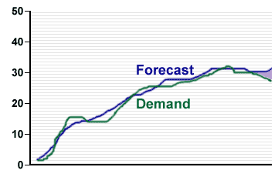
Predictive Science
“Retek presented with Supplier Excellence award at Retail Solutions Show in U.K….Retek demonstrated the strongest track record of designing and implementing start of the art solutions….”
Most accurate consumer demand forecast available for base and promotional items
Optimization leveraged to drive demand levers (Service Levels, Assortment, Space, Price)
Importance & Value
Metrics: Accuracy Benchmarks
$23 B Grocery Retailer
  14 % more accurate on turn items
  18 % more accurate on promotional items
$1.3 B Fashion Retailer
  27 – 42% more accurate during seasonal peaks
Benefits
  20 – 35 % reduction in safety stock
  20 – 40% increase in staff productivity
  Reduced inventory by 30% by pooling safety stock in DC and maintained service levels

Slide 12
Fastest Return on Investment
“Retek was named to Consumer Goods Technology Elite 100 vendor list…highest ranked in Return on Investment (ROI) and usability”
Proven process to identify and sustain value
Deliver benefit via best in class functionality through a modular architecture
Importance & Value
Metrics:
Minimum Order Quantity
12 weeks from data delivery
  Defined inventory management business strategies
  Reduced DOS 30% against control DC and LY
  Maintained service levels
100%
98.4%
98.2%
97.9%
98.1%
98.0%
97.4%
98%
A2
96%
Turns
Service Level
A1
94%
MOQ is the most powerful lever
+15.7%
92%
90%
Minimum Order Quantity

Slide 13
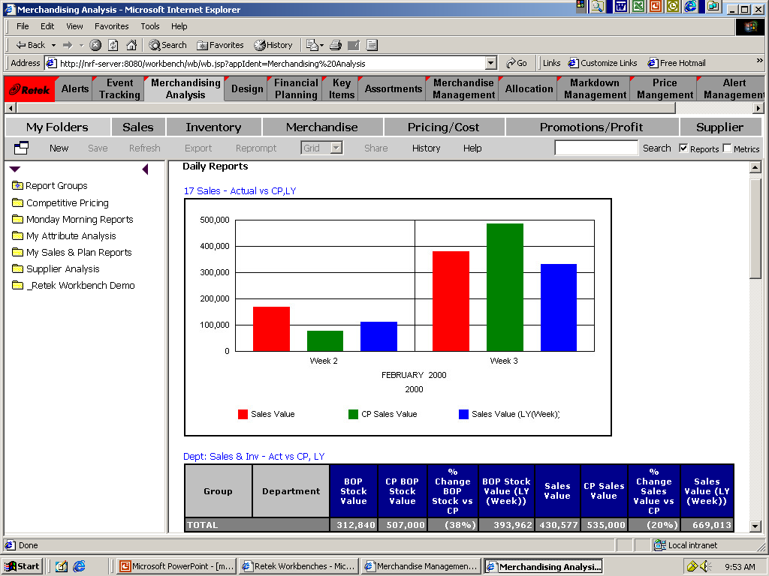
Technology
“ Retek 10 is the biggest ever investment in retail software development, with $100 M in investment and 160,000 man days of development…”
Near real time data availability via Retek EAI
Architecture designed to support infrastructure and best of breed
Single user sign on
Importance & Value
Metrics:
Retek Integration Bus
Predictive Solutions
Transactional
Solutions
Subscribe
Publish
Subscribe
Publish
Retek Integration Bus
Publish
Subscribe
Publish
Subscribe
Analytical Solutions
Legacy
Solutions

Slide 14
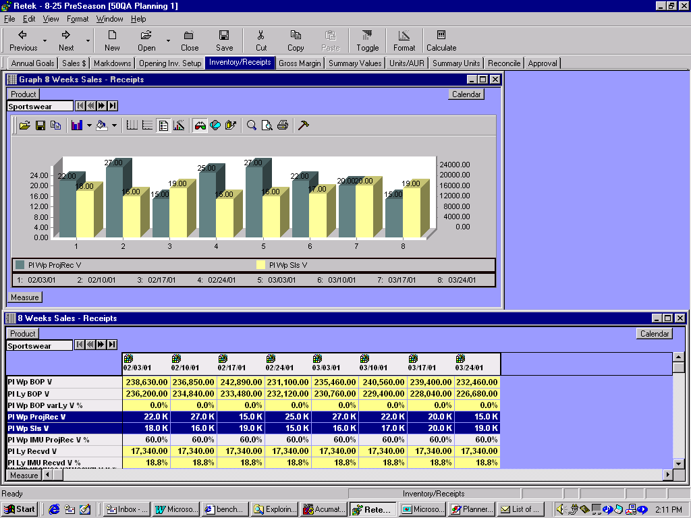
Business process appropriate interfaces
Forecasting & Planning Interface
Numerical and graphical views
Ability to perform ‘what if’ simulations
Allows complete freedom to ‘slice and dice’ business model
Supports exception management

Slide 15
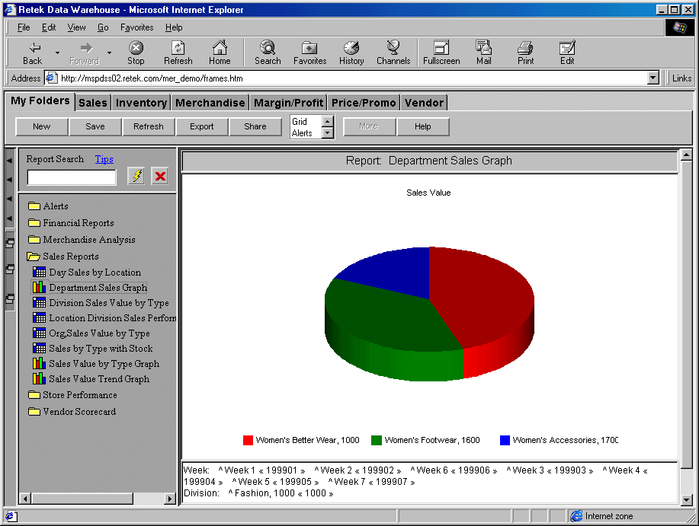
Business process appropriate interfaces
Analysis and Reporting Interface
Numerical and graphical views
Allows complete
freedom to ‘slice and dice’ business model
Supports exception management

Slide 16
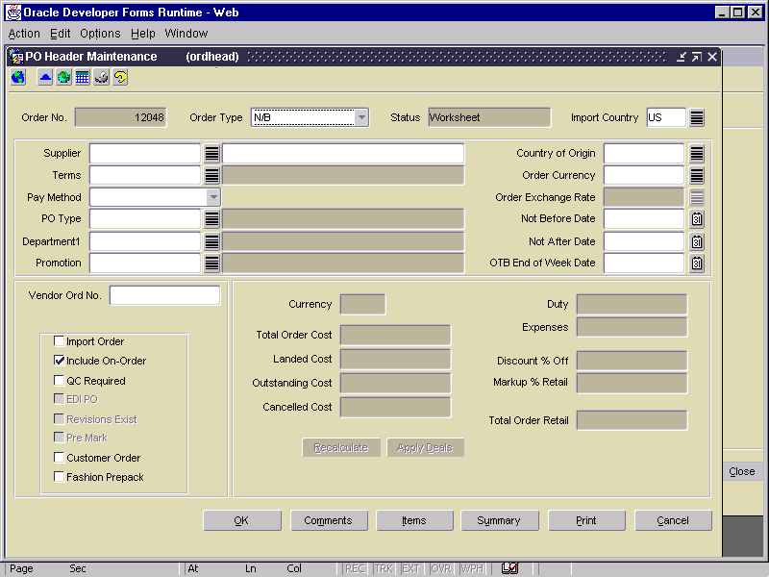
Business process appropriate interfaces
Operational Interface
Form based views focused on particular retail business process
Mass selection and change tools to aid user productivity
Supports exception management

Slide 17
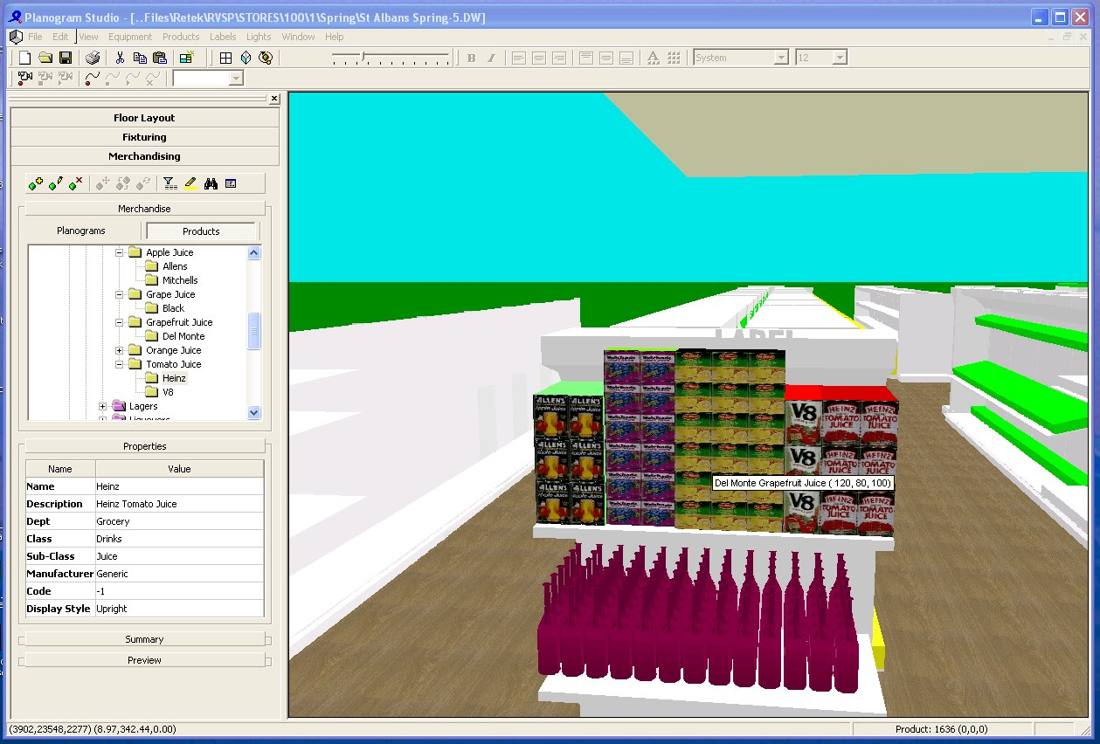
Business process appropriate interfaces
Space Management Interface
Direct support for CAD integration for floor plans
Support for macro/micro space management
Complete fixture/store space management
Support for store space performance analysis

Slide 18
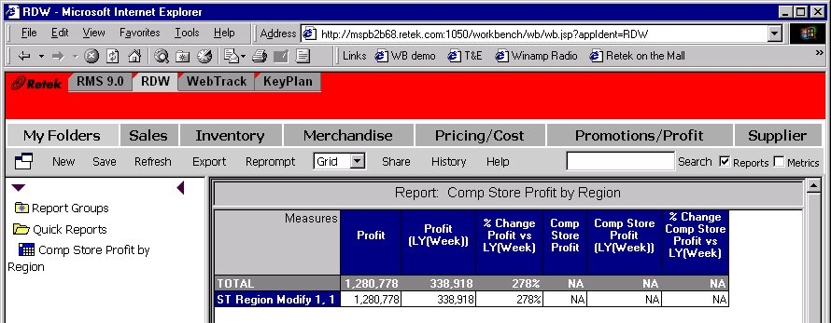
Unified Toolbar or direct access
Users can either:
  directly access individual Retek applications
  access multiple applications via Retek Workbench

Slide 19
Retek Presents
Accelerate speed to market
Maximize inventory turn
Minimize supply chain costs

Slide 20
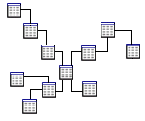
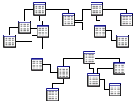
Supporting the Vision
De-Normalized Data
Snowflake Schema
Normalized Data
Multi-Dimensional
Highly De-Normalized
Places Used:
Reporting Applications
Reasons Used:
Performance
Places Used:
Transaction Systems
Reasons Used:
Highly Efficient
Places Used:
Granular Applications
Reasons Used:
Performance

Slide 21





Retek Deployment Architecture
Database
Server
Application
Server
Client
Store
Systems
Merchandising
System
Predictive
Applications
Data Warehouse

Slide 22
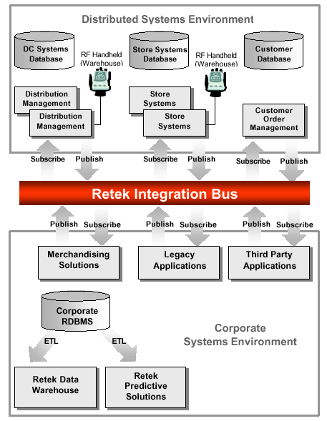
Retek EAI Strategy
Integration BUS enables ease of integration between:
  Retek Applications
  Retek Applications & Legacy Applications
  Legacy & Legacy
Depending upon application usage RIB supports both:
  Publish & Subscribe
  Extract, Transform, Load (ETL)

Slide 23
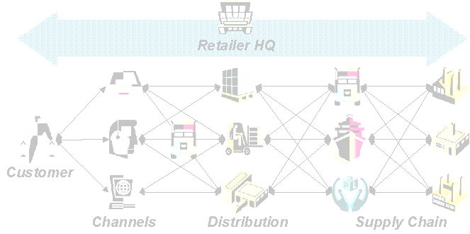
Retek Philosophy
CREATE Demand
MANAGE Demand
FULFILL Demand
Notes:
Enter on:
The challenge in today’s demanding market is connecting the dots. That is, coordinating all aspects of the selling functions with corporate operations and supply chain execution.
Supporting Content:
In the past, retailers had to focus on satisfying the needs of the consumer through 1 or 2 channels. Now a retailer may have many channels and the challenge is delivering a single, consistent view of the customer at every touch point.
But it’s not enough to have a single view of the customer. You also need to support your multiple selling channels with coordinated operations and an understanding of how these channels impact your core decision points. For example, how does it affect your buying process – does one buyer buy for all channels – do you have the same customer in all channels so that you can buy one range ? How do you manage inventory across multiple channels to maintain a cohesive brand, how do you balance inventory to maintain in service levels in both channels without sacrificing turn?
And it’s not enough for your operations to be coordinated or even for you to be coordinated with your suppliers. You now need to be tapped into a a flexible, responsive supply chain network that enables collaboration and fulfills consumer demand in a low cost manner.
Exit on:
These are the challenges, but the reality is that few retailers have systems architectures to address this completely and consistently. The key to success is linking the demand created to your supply chain so that it can be fulfilled effectively, so that you can maintain customer loyalty without sacrificing operational efficiency.

Slide 24
Create Demand
Understand Consumer Behaviour
  Local Market Behaviour
  Demand trends
  Within store activity
Target appropriate merchandise
  Range composition
  Price Strategy
  Promotional Activity
  Space Utilisation

Slide 25
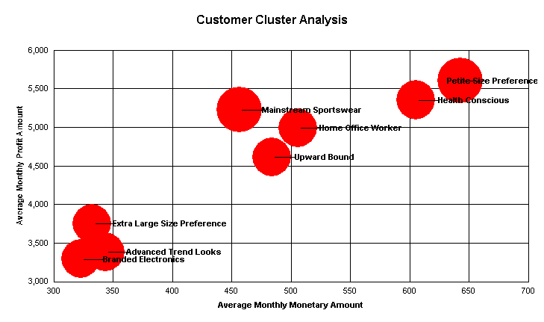
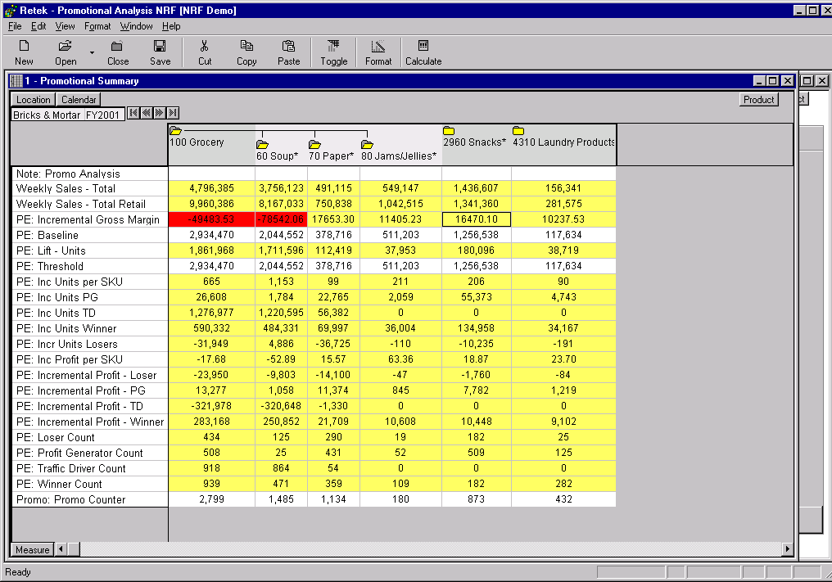
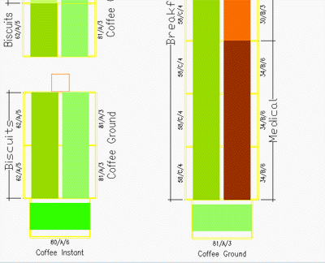
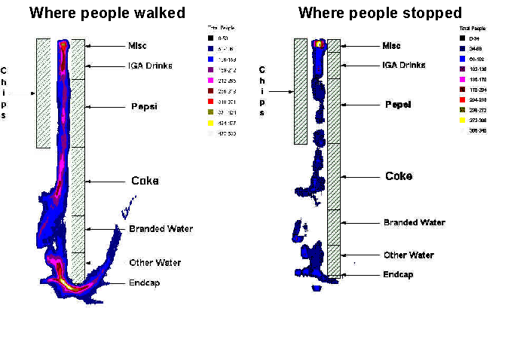
Understand Consumer Behaviour
Retek Data Warehouse – Consumer Centric Analysis
Retek Demand Forecasting –
Demand trends and promotional effectiveness
Retek Visual Space Planning –
Store performance analysis by space allocation
Retek Brickstream –
Within store consumer analysis based on actual observation

Slide 26
Functional Reporting Areas
Merchandising
Sales
Inventory
Merchandise
Pricing/Cost
Promotions/Profit
Supplier
Location Performance
Store Operations
Productivity Analysis
Store Performance
Loss Prevention
Inventory
Supplier Compliance
Customer
Multi Channel Analysis
Customer Analysis
Product & Customer Affinity Analysis
Target Marketing
Campaign Performance
Category Management
Category Scorecards
Trend Report
Assortment Efficiency
Market Analysis
Promotion Efficiency
Inventory and Plan Analysis
Supplier Performance

Slide 27
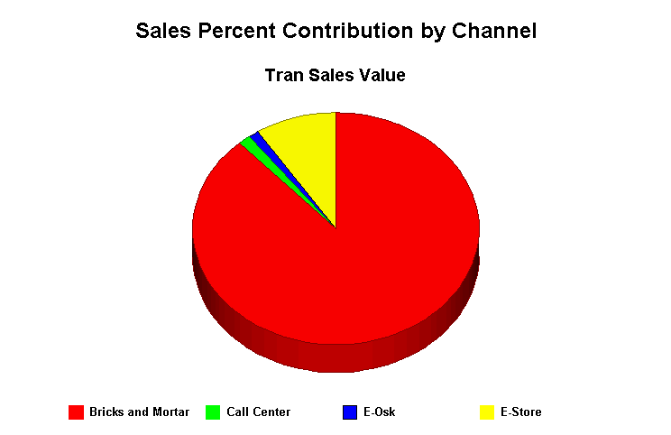
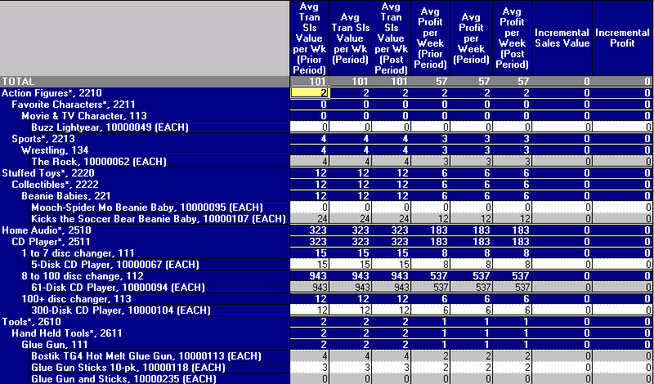
Understand Consumer Behaviour
Retek Data Warehouse – Consumer Centric Analysis

Slide 28
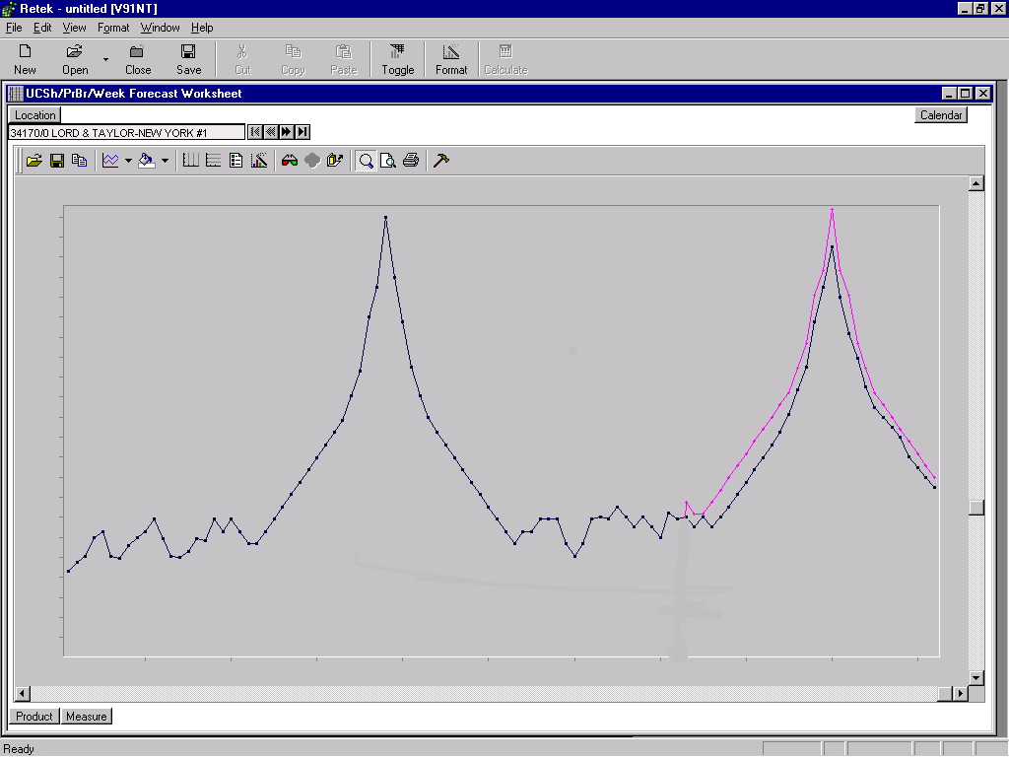
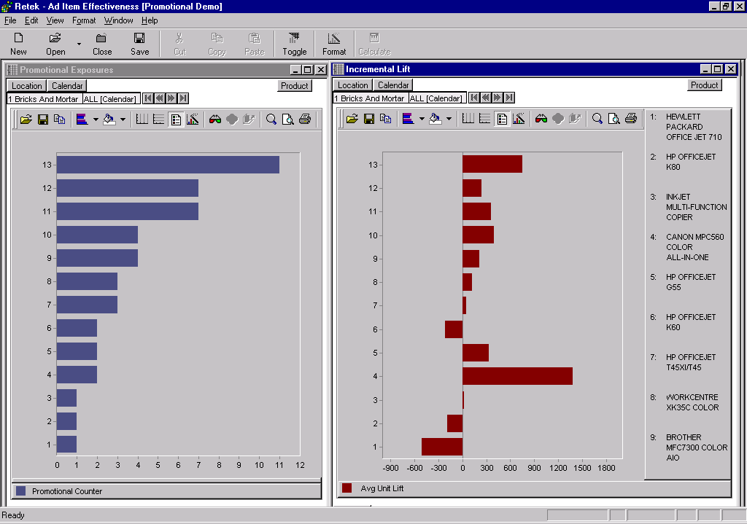
Understand Consumer Behaviour
Retek Demand Forecasting – Demand trends and promotional effectiveness

Slide 29
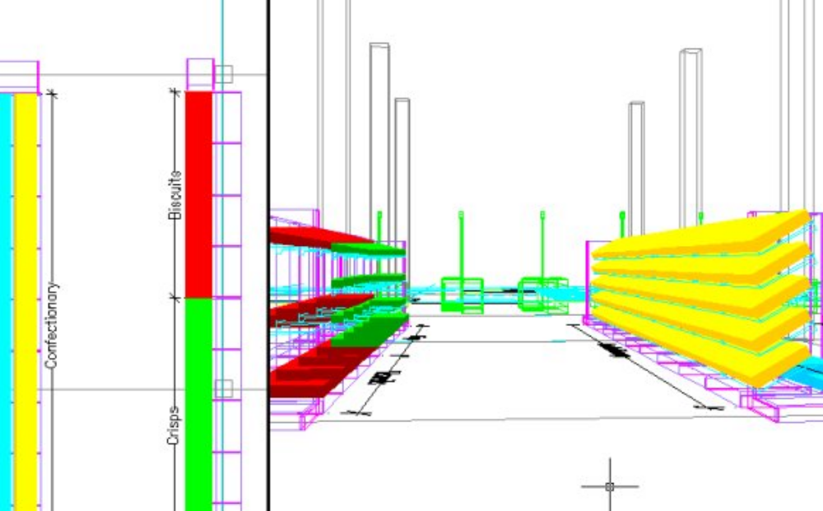
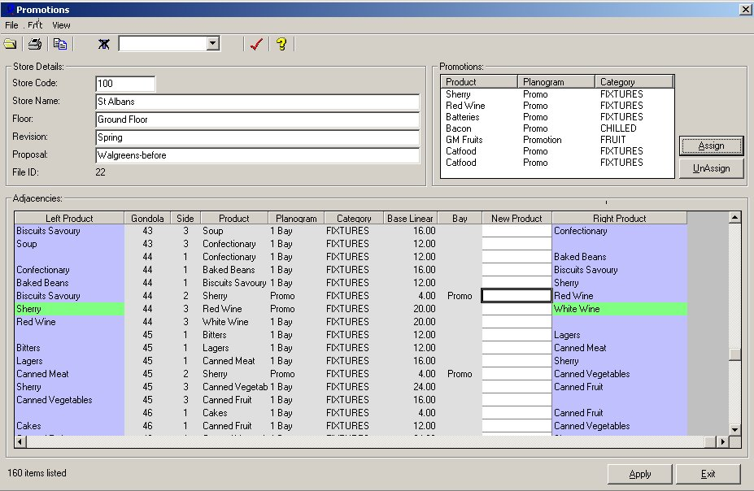
Understand Consumer Behaviour
Retek Space – Store performance analysis by space allocation

Slide 30
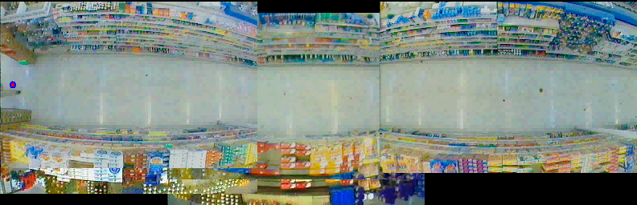

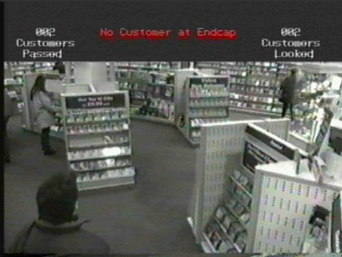
Understand Consumer Behaviour
Retek Brickstream – Within store consumer analysis based on actual observation
Consumer is moving
Consumer slows
Consumer Stops

Slide 31
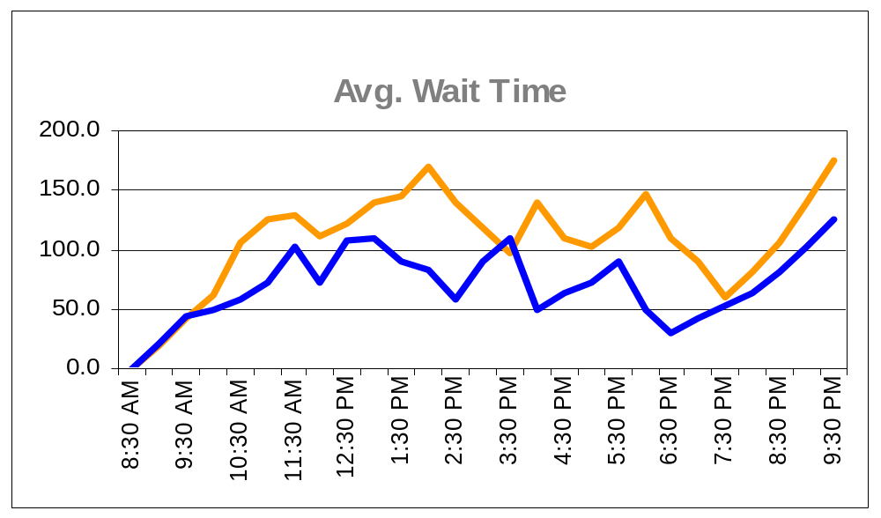
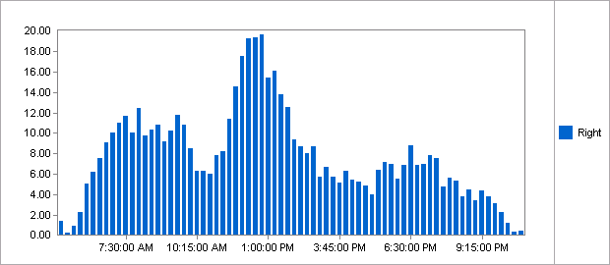
Understand Consumer Behaviour
Retek Brickstream – Within store consumer analysis based on actual observation

Slide 32
Create Demand
Understand Consumer Behaviour
  Local Market Behaviour
  Demand trends
  Within store activity
Target appropriate merchandise
  Range composition
  Price Strategy
  Promotional Activity
  Space Utilisation

Slide 33
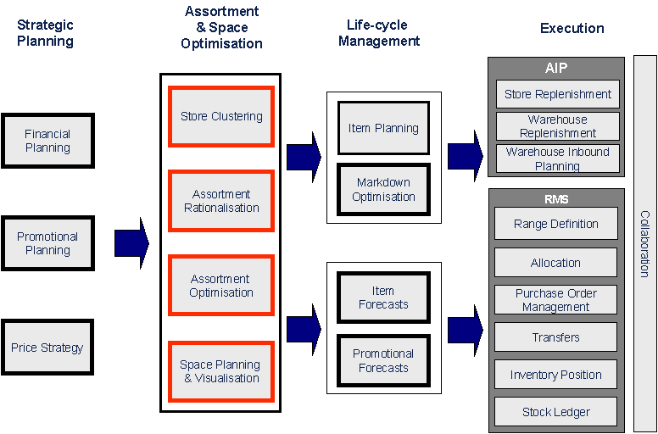
High-level process flow

Slide 34
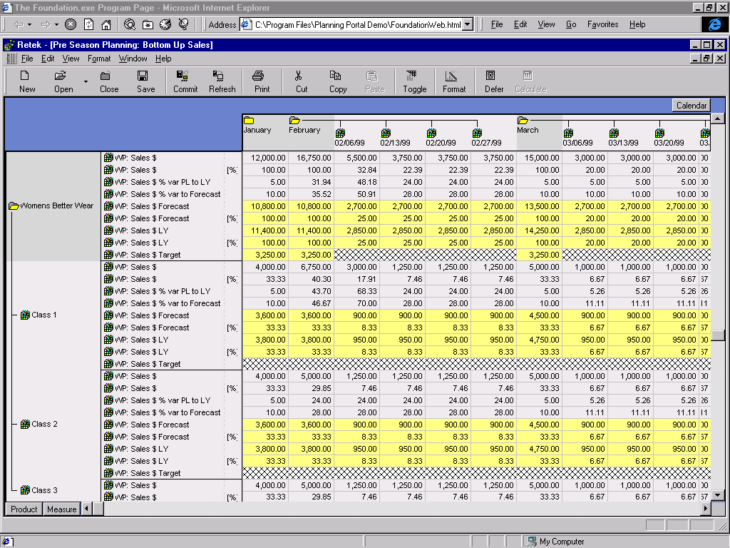
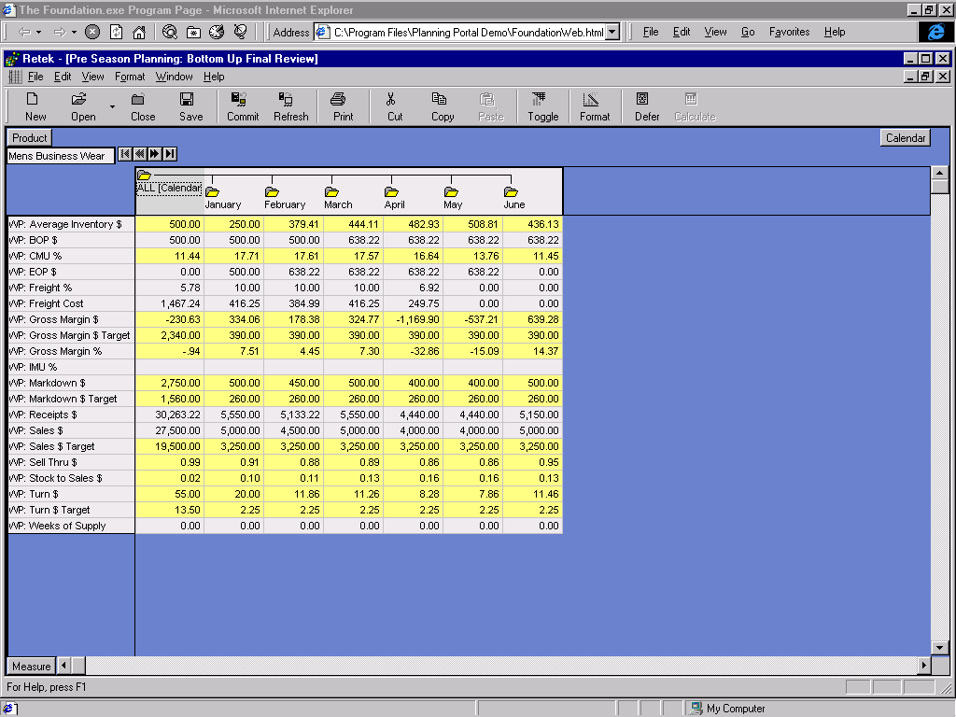
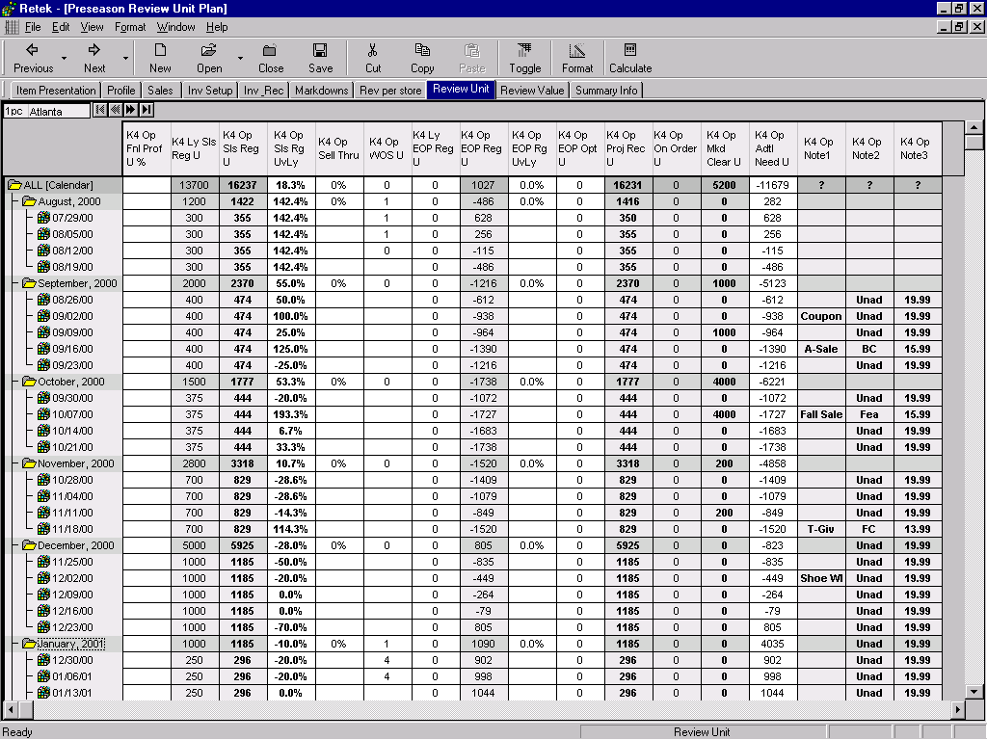
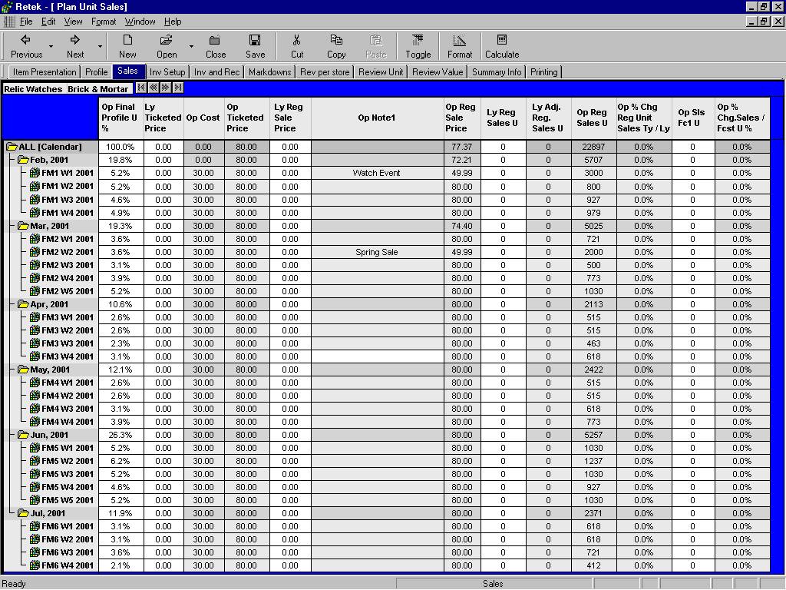
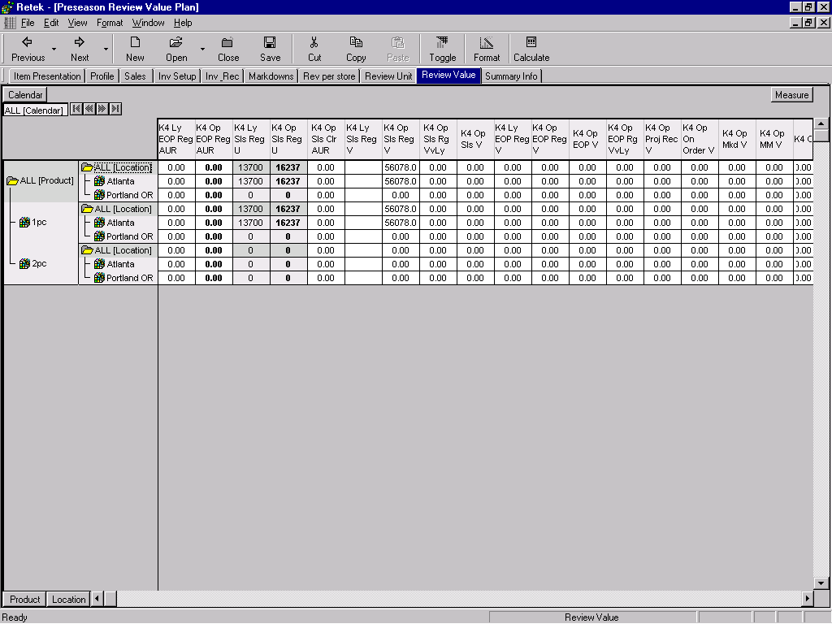
Range & Space Planning
Strategic & Tactical Planning
  Merchandise: Total Company – Category
  Channel: Total Company – Store
  Revenue
  Inventory
  Orders and Receipts
  Margins
Retek TopPlan
Operational Planning
  Merchandise: Category - SKU
  Channel: Store Cluster
  Revenue
  Inventory
  Orders and Receipts
  Margins
Retek KeyPlan

Slide 35
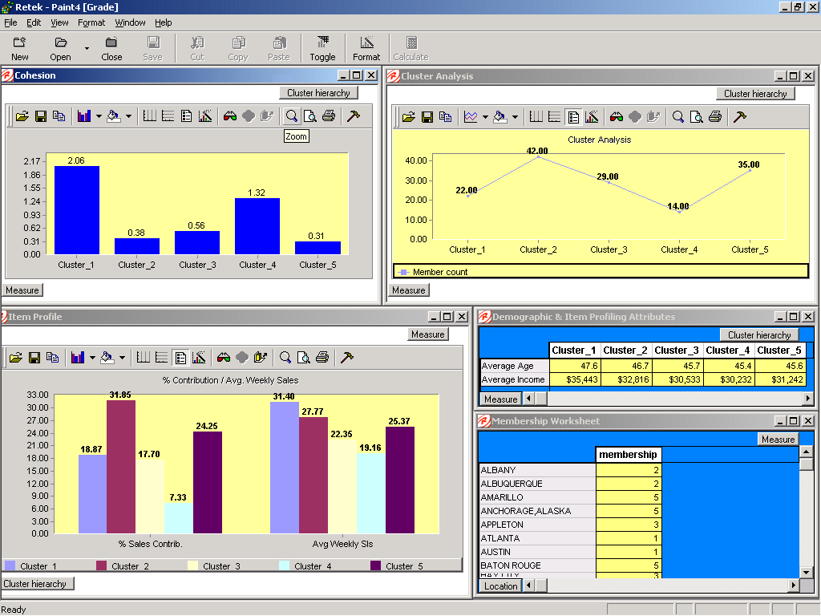
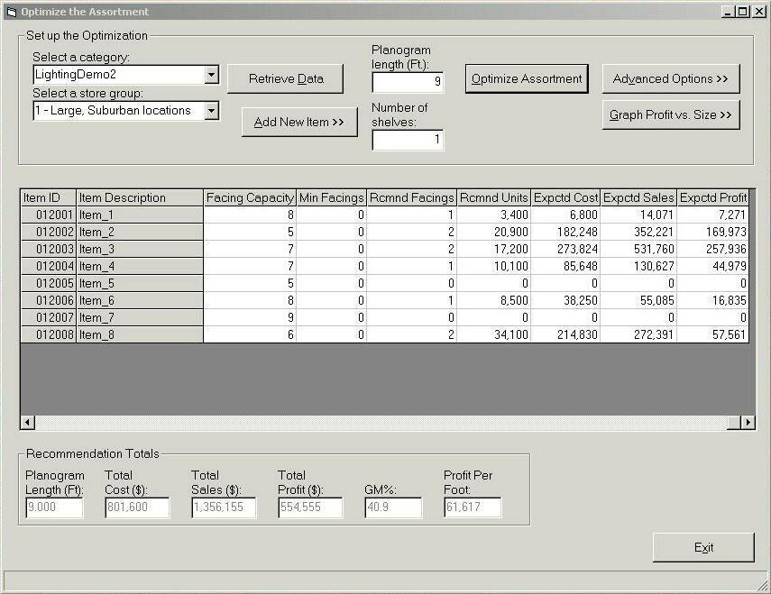
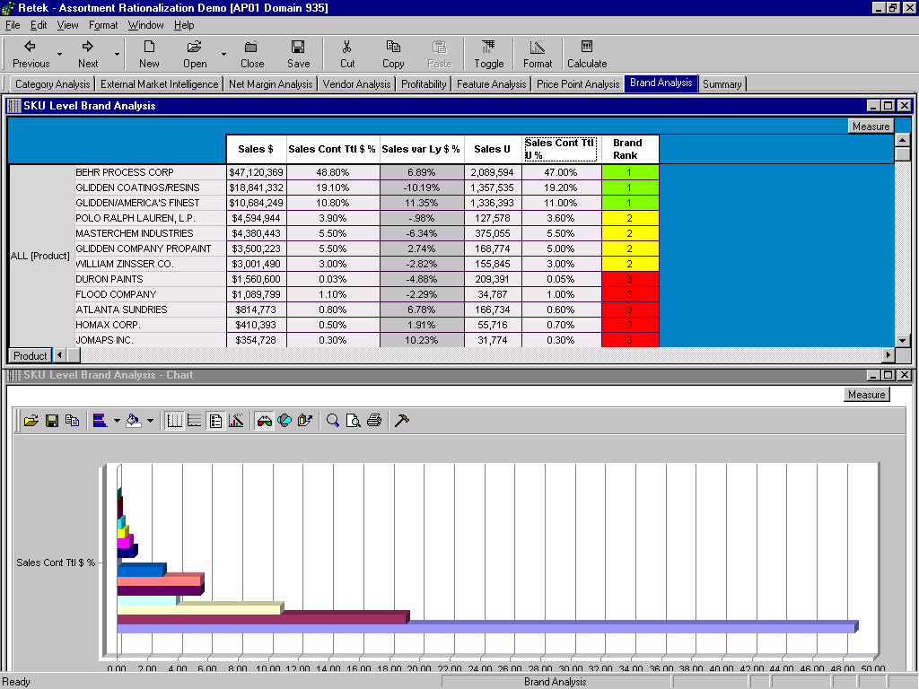
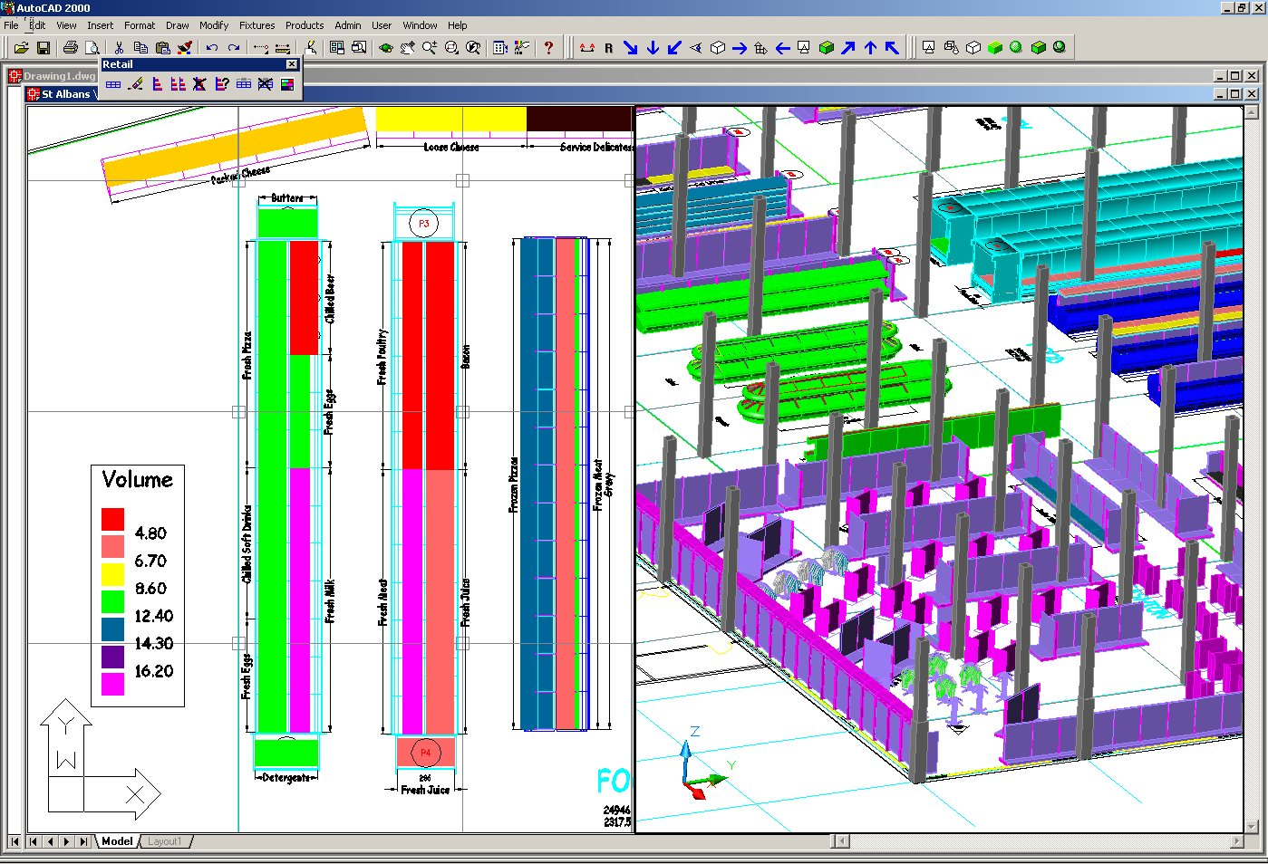
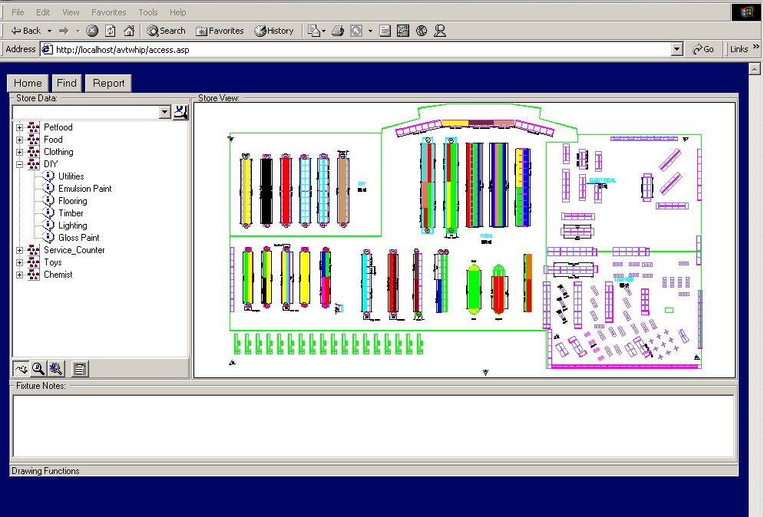
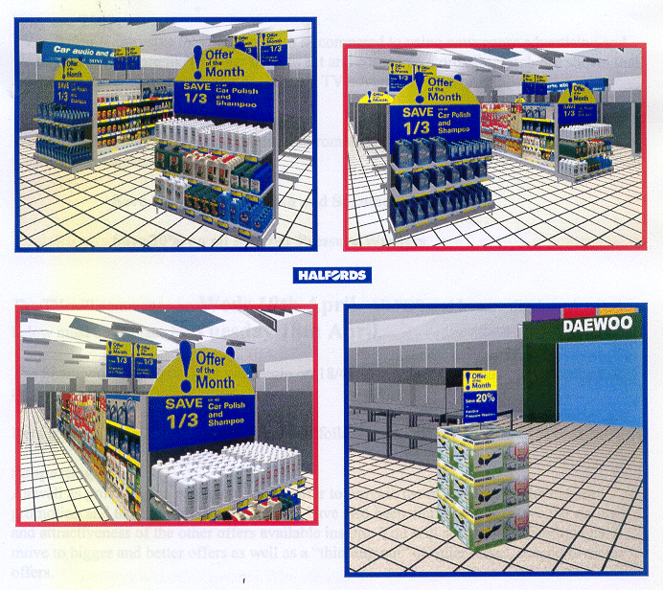
Range & Space Planning
Assortment Planning
  Merchandise: Category – SKU
  Channel: Store Cluster
  Store Clustering
  Assortment Rationalisation
  Assortment Planning
  Assortment Optimisation
  Space Optimisation
Retek Assort
Space Management
  Merchandise: Category - SKU
  Channel: Store Cluster - Store
  Macro Space Management
  Micro Space Management
  Fixture/Store Management
  3D visualisation
  Store Space Performance
  Store Communication
Retek Visual Space Planning

Slide 36
Range & Space Planning
Retek TopPlan
Retek Assort
Retek KeyPlan
Retek Visual Space Planning

Slide 37
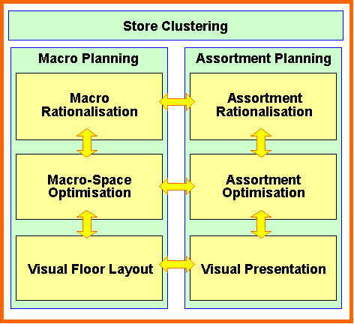
Assortment and Space Optimisation (ASO)
ASO is integrated with other key business processes and determines both high-level space strategies and specific item presentation by store.
Strategise
Optimise
Visualise

Slide 38
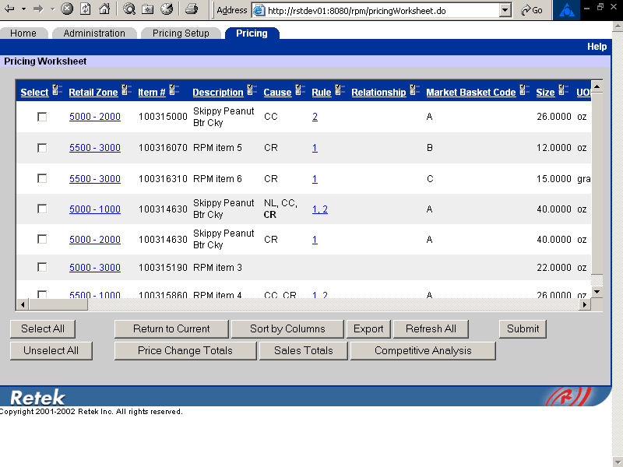
Pricing & Promotions
Retek Price Management
Retek Promote

Slide 39
Closed Loop Process
Pricing Strategy
Price Change Execution
Monitor Process

Slide 40

Pricing Strategies & Setup
Pricing Strategies Supported:
Relationship
  Lead item based on market basket codes
  Competitive or Margin calculation for lead item retail
  Retails proposed based on item size relationship by margin target or percent of lead item profit
Competitive
  Retails proposed based on competitive goals by merchandise hierarchy level
  Consideration for an item’s market basket code when defining competitive goals

Slide 41
Pricing Strategies & Setup
Pricing Strategies Supported:
Margin
  Margin goals applied to items based on merchandise hierarchy level
  Consideration for an item’s market basket code when defining margin goals
Clearance
  Ability to define % markdowns based on the regular retail or last clearance retail

Slide 42
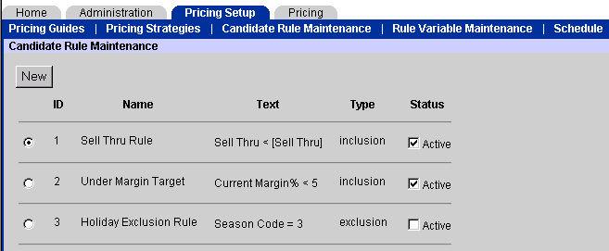
Pricing Strategies & Monitoring
Pricing Rules
Rule engine to build rules:
  Globally with value variations at the department level
  To include or exclude items for pricing review
  One or many conditions per rule
  Active or Inactive status

Slide 43
Pricing Strategies & Monitoring

Slide 44
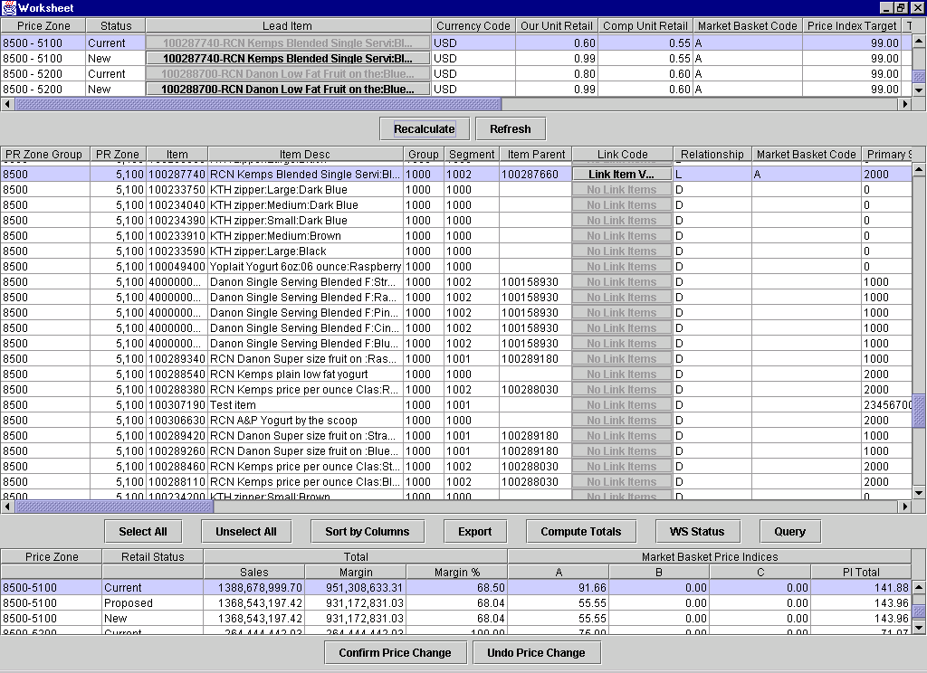
Pricing Review and Changes
Lead Item
Associated Category Items
Category Impact

Slide 45
Price Change Execution
Functional integration to Retek Execution Layer
Price Changes and impacts are sent to
  Ticketing
  Store System
  PoS
  Shelf Edge Labels
  Warehouse System
  Labour planning
  Merchandising etc…
Price Change
Execution

Slide 46
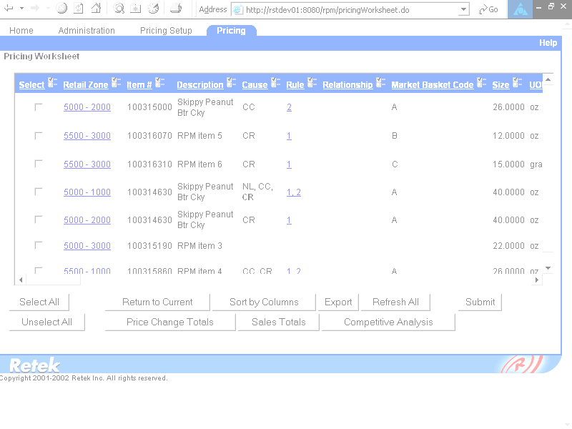
Pricing & Promotions
Retek Price Management
Retek Promote

Slide 47
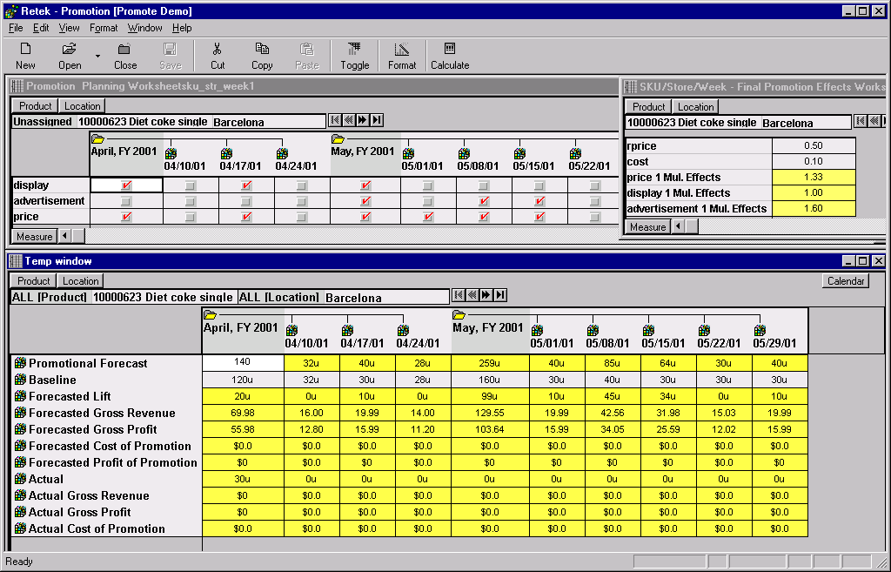
Promotional Planning: What-If Analysis
Item Level view of pre-selected items for the June 16 promotion.
This view shows the forecasted sales and margin for the promotion. Additional changes can be made to the promotional plan at this time.
As you input or modify the promotional components (example: display, ad incorporation, and markdown) the forecast will change real-time.

Slide 48
Lift by Exposure
This example shows the comparison of items in a class. The left graph shows the number of times that the item was promoted, the right shows the average unit lift per promotion.
Stop Promoting
These Items!
Stop Promoting
These Items!
Promote This
Item Instead!

Slide 49
Retek Philosophy
CREATE Demand
MANAGE Demand
FULFILL Demand
Notes:
Enter on:
The challenge in today’s demanding market is connecting the dots. That is, coordinating all aspects of the selling functions with corporate operations and supply chain execution.
Supporting Content:
In the past, retailers had to focus on satisfying the needs of the consumer through 1 or 2 channels. Now a retailer may have many channels and the challenge is delivering a single, consistent view of the customer at every touch point.
But it’s not enough to have a single view of the customer. You also need to support your multiple selling channels with coordinated operations and an understanding of how these channels impact your core decision points. For example, how does it affect your buying process – does one buyer buy for all channels – do you have the same customer in all channels so that you can buy one range ? How do you manage inventory across multiple channels to maintain a cohesive brand, how do you balance inventory to maintain in service levels in both channels without sacrificing turn?
And it’s not enough for your operations to be coordinated or even for you to be coordinated with your suppliers. You now need to be tapped into a a flexible, responsive supply chain network that enables collaboration and fulfills consumer demand in a low cost manner.
Exit on:
These are the challenges, but the reality is that few retailers have systems architectures to address this completely and consistently. The key to success is linking the demand created to your supply chain so that it can be fulfilled effectively, so that you can maintain customer loyalty without sacrificing operational efficiency.

Slide 50
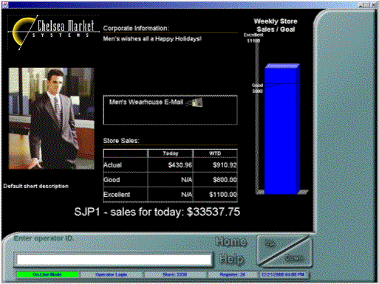
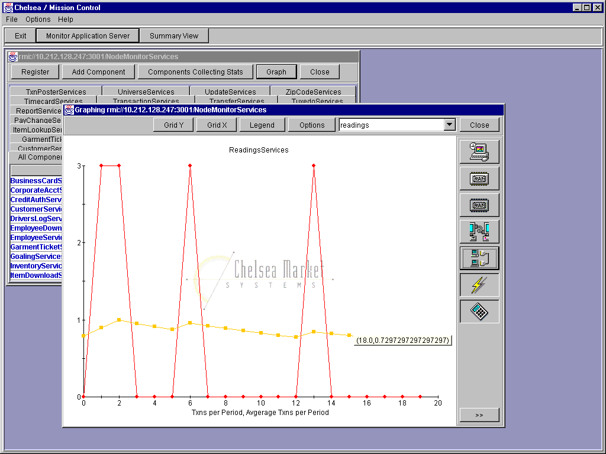
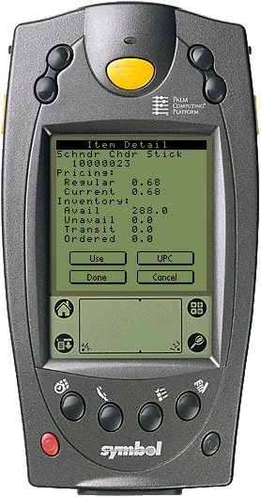
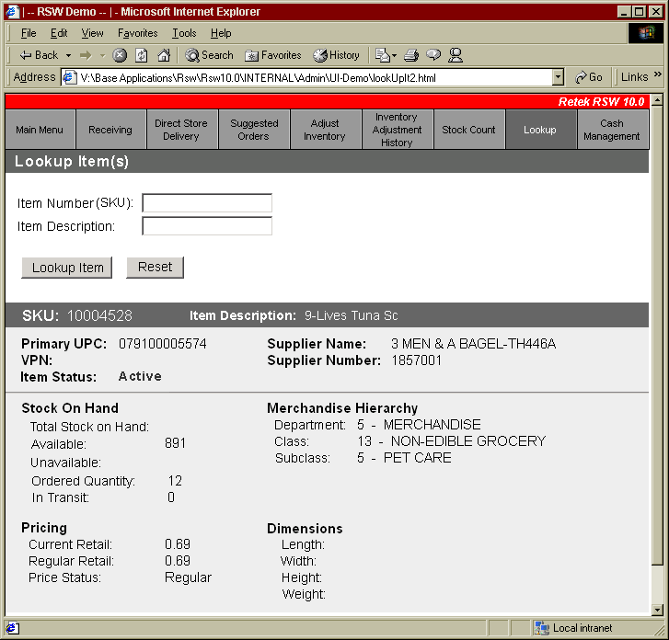




Manage Store & Multi-Channel
Retek Point of Service –
Complete EPOS store solution supporting multi-channel interaction
Retek Store System –
Store inventory & operations management and shelf replenishment solution
Retek Customer Order Management –
Powerful, multi-application exception monitoring and user directed workflow for problem resolution

Slide 51

Why Java POS?
Flexible - Java-based architecture enables multi-platform, multi-channel operation. Retek’s application tools let business analysts monitor and modify various function.
Reliable - Get 99.999% availability with built-in fault tolerance and no single point of failure.
Scalable - Multi-tiered, physically distributed architecture extends system life.
Manageable - Debugging and tuning can be done locally or remotely.
Rules-based operations - Changes can be made once and pushed out to all system components.
Reusable – Object-oriented design facilitates changes and expansion of applications and components.

Slide 52
Why Java POS?
Portability - Available on most hardware systems
Cost effective - Runs on a simple (thin) client computer system
Faster Development and Deployment - Through code reusability, easier testing and rapid deployment through intranet/network.
Better Security - Inspects all code for viruses and tampering
High performance - Built in multi-threading speeds graphical applications
Flexible design - Object oriented design focuses on data
Network savvy - Extensive routine library

Slide 53


Complete Application Builder
Add menu options
Apply business rules
Define, add, and modify transaction related business rules
Generate commonly used application code
Drag and drop to design the flow of screens

Slide 54
Mission Control dynamically tunes individual components
Optimise utilisation dependent on client requests
Monitor, record and graph server statistics
View vitals and log files
Change rules to tune components
Red Light/Green Light identifies exceptions

Slide 55
Wide variety of point-of-service activities streamline operations
Sales/Returns/Exchanges
Layaways
Mixed transactions
Non-merchandise sales
Suspend/Recall (peer to peer)
Transaction level commissions
Customer profiling at POS
Line item markdown Value or %
Promotional pricing
Sales reports
Transaction discounts Value or %
Gift certificates or receipts
Unlimited split tendering
Credit/Check authorization
Foreign currency support
Duplicate receipts
Transaction re-entry
Store audits

Slide 56
Client Specific Deployments

Slide 57





Manage Store & Multi-Channel
Retek Point of Service –
Complete EPOS store solution supporting multi-channel interaction
Retek Store System –
Store inventory & operations management and shelf replenishment solution
Retek Customer Order Management –
Powerful, multi-application exception monitoring and user directed workflow for problem resolution

Slide 58
Retek Store Systems
Any
Handheld
Device
Any Browser
Enabled Client
(POS Terminal,
Kiosk, Etc…)
Retek Store Systems Platform
Inventory
Management
Cash
Management
In-Store
Shelf
Replenishment
Store
Manager
Analytics
Special
Order
Management
Other Channels
Web Store
Real Time APIs
Call Center
Retek
Customer
Order
Management
Retek Sales
Audit
Retek
Merchandising
System
Retek Data
Warehouse
Retek Store
Replenishment
Retek
Demand
Forecasting

Slide 59
Inventory Management
Retek Store Systems Platform
Inventory
Management
Point of
Service
In-Store
Shelf
Replenishment
Store
Manager
Analytics
Customer
Management
Move store employee inventory management tasks
to the sales floor instead of of the backroom
Features
Transfer merchandise between stores
Receive merchandise
Process returns to vendors (RTV)
Count and adjust inventory
Lookup supplier and item information
Search for merchandise inventory
Print tickets, shelf labels, and carton labels
Maximize employee productivity
Keep employees accessible to customers, improving sales and service
Improves perpetual inventory management
Benefits

Slide 60



In-Store Shelf Replenishment
Retek Store Systems Platform
Optimize in-stock positions at the shelf and replenishment process efficiencies
Inventory
Management
Point of
Service
In-Store
Shelf
Replenishment
Store
Manager
Analytics
Customer
Management
Features
Dynamically calculates shelf stock positions throughout the selling day
Generates prioritized pick lists for replenishing products from back room to sales floor
Assigns in-store destinations and restock priorities to merchandise during the receiving process
Configurable replenishment algorithm based on POS sales data as well as causal demand forecasts
Improve customer service
Capture lost sales
Maximize employee productivity
Reduces stock count frequency
Benefits

Slide 61


Store Manager Analytics
Retek Store Systems Platform
Inventory
Management
Point of
Service
In-Store
Shelf
Replenishment
Store
Manager
Analytics
Customer
Management
Manage store resources optimally by understanding
employee productivity and shrink
Features
Store Manager Analysis and Alerts:
Employee productivity
Loss Prevention
Customer service
Store Performance
Inventory Analysis
Vendor Compliance
Customers in Queue
Benefits
Improve employee productivity
Lower labor costs
Decrease shrink
Improve customer service and coverage
Increase customer loyalty

Slide 62


Customer Management
Retek Store Systems Platform
Inventory
Management
Point of
Service
In-Store
Shelf
Replenishment
Store
Manager
Analytics
Customer
Management
Serve customers more effectively with visibility to customer history and multi-channel inventory
Features
Captures and tracks customer special orders for home delivery or store pickup
Extends access to inventory availability across channels
Provides customer history visibility, cross channel returns, and clientelling capabilities to in-store sales associates
Capture lost sales
Improve customer service
Lower inventory costs
Benefits

Slide 63
Major Areas
Item Lookup
Receiving
Transfers
Direct Store Deliveries
Return to Vendors
Shelf Replenishment
Inventory Adjustments
Stock Counts
Price Reductions
Store Sequencing

Slide 64



Manage Store & Multi-Channel
Retek Point of Service –
Complete EPOS store solution supporting multi-channel interaction
Retek Store System –
Store inventory & operations management and shelf replenishment solution
Retek Customer Order Management –
Powerful, multi-application exception monitoring and user directed workflow for problem resolution

Slide 65
Life of an Order
Order Status
Pick Ticket/Shipment Status
Pend Order
Pending
Process
New
Release Order
Release Order
Released
Pick Release (man. or auto.)
R = Released
Picking
PRT = Pick Ticket Printed/ Pick Released
Open Manifest
Pick Confirm
PCKCNF = Pick Confirmed
Cancel Order
Ship Confirm
Canceled
MAN = Applied to manifest
STG = Staged for shipping
X = Canceled
Close Manifest
Closed
SHIP = Packaged Shipped

Slide 66


Slide 67






Merchandising Operations
Retek Merchandising Solution –
Complete merchandising operations solution with a ‘near’ real time view of perpetual inventory within the business
Retek Price Management –
Price management solution comprising support for pricing strategies, price monitoring and price change evaluation
Retek Active Retail Inteligence –
Powerful, multi-application exception monitoring and user directed workflow for problem resolution

Slide 68
Retek Merchandise System (RMS)
An integrated foundation:
Business Foundation Management for a solid foundation for your core data
Merchandise Management for key day-to-day buying and selling activities
Financial Management for profitability analysis and recording inventory results
Financial Management
Business Foundation Management
Merchandise Management

Slide 69

Retek Merchandise System (RMS)
Business Foundation Management
Sets the groundwork for all key data in the Merchandising System and includes:
  Organizational and Merchandise Hierarchies
  Vendor Management
  Item Maintenance
  Grouping Tools
  Multi-language & Currency
  Security Controls
Item
Maintenance
Supplier
Management
Merchandise/
Organization
Hierarchies
Grouping
Tools
Security
Multi
Language
Multi
Currencies

Slide 70
Retek Merchandise System (RMS)
Merchandise Management
Provides the power and processes behind a retailer’s day-to-day buying and selling activities, such as:
  Purchasing
  Contracts
  Deals Management
  Inventory Control
  Replenishment (Extension)
  Allocation (Extension)
  Promotion Management
  Cost and Retail Price Management
Promotions
Inventory
Control
Management
of Cost &
Retail
Pricing
Purchasing
& Contracts
Complex Deals
Management
Replenishment
Allocation

Slide 71
Retek Merchandise System (RMS)
Financial Management
Records and analyses inventory results and merchandise processes daily to determine success and profitability
  Stock Ledger
  Open-to-Buy
  Integration with Invoice
  Matching
  Integration with ‘best-of-breed’ financial packages
  Integration with ‘best-of-breed’ HR packages
Stock Ledger
Open
to
Buy
Integration to General
Ledger

Slide 72
Retek Merchandise System (RMS) v10
Key Features:
Item structure
Multi-Channel
Future cost
Investment buy
Supplier pooling
Buyer worksheet
Location up charges

Slide 73


Foundation Data

Slide 74
Foundation Data Elements
ITEMS:
547/6907 BT Cellnet Nokia 5510
440/2408 Braun Oral B 3D Excel Family Power Toothbrush
SUPPLIERS:
Nokia
Braun
ITEMS
SUPPLIERS
LOCATIONS:
Stores
Warehouse(s)
Distribution Centers
LOCATIONS
DATA INTERSECTION POINTS.
NOTE: Each Foundation Data Element represents the potential for a ‘ONE-TO-MANY’ relationship.

Slide 75
Perpetual Inventory Visibility
Corporate Management can SEE and KNOW all inventory positions and flows .
POS Store Sales
Corporate Office Data Base
Available Inventory On Hand
Stores
Sales
Customers
Available Inventory On Hand
Purchase Orders
Transfers
Ship to store
Returns
On Hand Inventory
Stores
Vendors / Suppliers
Direct to store
In-store Inventory Adjustments
Warehouses
Ship to warehouse
Warehouse Inventory Adjustments

Slide 76






Merchandising Operations
Retek Merchandising Solution –
Complete merchandising operations solution with a ‘near’ real time view of perpetual inventory within the business
Retek Price Management –
Price management solution comprising support for pricing strategies, price monitoring and price change evaluation
Retek Active Retail Inteligence –
Powerful, multi-application exception monitoring and user directed workflow for problem resolution

Slide 77
Pricing Operation
  Optimisation
  Engines
Visibility,
Selection
and Approval
Price Change
Execution
  Planning
Interactive
Analysis
Global Constraints
price change types - location clustering
- business rules - customer clustering
- price points - financial plan
- labour constraints - hard/soft constraints
- pricing levels - price change prioritisation

Slide 78
Pricing Review and Changes
Lead Item
Associated Category Items
Category Impact

Slide 79


Merchandising Operations
Retek Merchandising Solution –
Complete merchandising operations solution with a ‘near’ real time view of perpetual inventory within the business
Retek Price Management –
Price management solution comprising support for pricing strategies, price monitoring and price change evaluation
Retek Active Retail Inteligence –
Powerful, multi-application exception monitoring and user directed workflow for problem resolution

Slide 80
ARI within Retek deployment
Business Rules and Workflow Processes
Merchandising
Inventory Management
Warehouse
Management
Data Warehouse
External Oracle
Enhanced
Business
Results
Exception
Monitor
Events
Alerts
Actions
Active Retail Intelligence
Data
Information
Knowledge
Actions
Results
Notes:
Data is filtered for critical issues
Exceptions are raised in two ways
Real time
Batch scan
Exceptions are filtered by business rules to create events
Events have two possible outcomes
auto-action
user alert
Alerts notify the correct users that an event has been raised
Where an alert is raised users can go online and action the associated event
Actions are tied to business priorities

Slide 81
ARI within Retek deployment

Slide 82
Retek Philosophy
CREATE Demand
MANAGE Demand
FULFILL Demand
Notes:
Enter on:
The challenge in today’s demanding market is connecting the dots. That is, coordinating all aspects of the selling functions with corporate operations and supply chain execution.
Supporting Content:
In the past, retailers had to focus on satisfying the needs of the consumer through 1 or 2 channels. Now a retailer may have many channels and the challenge is delivering a single, consistent view of the customer at every touch point.
But it’s not enough to have a single view of the customer. You also need to support your multiple selling channels with coordinated operations and an understanding of how these channels impact your core decision points. For example, how does it affect your buying process – does one buyer buy for all channels – do you have the same customer in all channels so that you can buy one range ? How do you manage inventory across multiple channels to maintain a cohesive brand, how do you balance inventory to maintain in service levels in both channels without sacrificing turn?
And it’s not enough for your operations to be coordinated or even for you to be coordinated with your suppliers. You now need to be tapped into a a flexible, responsive supply chain network that enables collaboration and fulfills consumer demand in a low cost manner.
Exit on:
These are the challenges, but the reality is that few retailers have systems architectures to address this completely and consistently. The key to success is linking the demand created to your supply chain so that it can be fulfilled effectively, so that you can maintain customer loyalty without sacrificing operational efficiency.

Slide 83



Multiple routes to consumer
Supplier to Customer

Supplier to Store
Pre-Distribution
Cross Dock
Supplier to DC
DC to store

DC to Customer

Slide 84
Challenges in Accurate Forecasting
Different products types need different forecast algorithms:
Seasonal trend Winter’s Model, Seasonal Regression
Spikes and dips Holt’s Model
New items / New stores Exponential Smoothing models
Short life products Profiling and Bayesian Models
Slow moving items Crostons method
Promotional items Causal Models & ROI Analysis
Solution can auto-select correct algorithm and will ‘shift’ method of sales pattern shifts

Slide 85
Challenges in Accurate Forecasting
Product
Hierarchy
Location
Hierarchy
Different products types need to be forecast at different levels:
Division
Company
Aggregation and spreading algorithms are used across defined hierarchies to ensure that final forecast is accurate
Department
Chain
Class
Area
Generate forecast at
Sub-Class
Region
Source Level:
Subclass/Region
Style
District
Sku Sales By Location
Final Forecast: SKU/Location Level
SKU
Store

Slide 86
Challenges in Accurate Forecasting
Causal events and promotions have to be accounted for:
Forecast Date
Sales
Forecast
Promotions

Slide 87


Retek makes it easy
Automatic selection of “best fit” algorithm for every product
System generates forecast and user reviews and manipulates by exception
Approval process can be automated
Aggregation at all levels of product, time and supplier
Automatic integration of forecasting into replenishment and ordering
Monitor performance of actual against forecast
Notes:
Slide Objective: A summary slide. Reiterate the ease of use through automation, exception management and accuracy all done a at sku/store level every time a forecast is generated.
Another key message to deliver on this slide is to speak about Forecast Scorecard. In most cases this is the only time you will talk about it. Retek maintains the system generated forecast as well as any changes made by the users. Forecast accuracy is measured against both forecasts over time and you can determine the impact on accuracy the users have on the forecast.

Slide 88


Replenishment & Allocation Overview
Push based Allocation solution
Supports simple allocation through to allocations based on a forecast or plan.
Can be implemented ‘stand alone’ or as part of complete merchandising solution
Retek Replenishment & Allocation Solution
Pull based Replenishment solution
Supports simple replenishment through to replenishment based on a forecast.
Can be implemented ‘stand alone’ or as part of complete merchandising solution
Notes:
Need to rework slide and script based on Sainsbury / replenishment planning stuff
Replenishment and Allocation : where the rubber hits the road in SCM
Replenishment at Store level not only to dc
Constraint based
Replenishment opt : speed to value

Slide 89
Replenishment & Allocation Overview
Sales
Seasonal
Continuous
Complete Lifecycle
Replenish Only
Different capabilities for different needs
From simple model stock replenishment and allocation to complex, constraint based, time phased replenishment and allocation
Allocate Only
Notes:
Need to rework slide and script based on Sainsbury / replenishment planning stuff
Replenishment and Allocation : where the rubber hits the road in SCM
Replenishment at Store level not only to dc
Constraint based
Replenishment opt : speed to value

Slide 90
Replenishment & Allocation Overview
Sales
Seasonal
Continuous
Complete Lifecycle
Replenish Only
Different capabilities for different needs
Replenishment can be fully automatic, with approval required or via exceptions
Allocations can be automatically released or require approval and user intervention
Allocate Only
Notes:
Need to rework slide and script based on Sainsbury / replenishment planning stuff
Replenishment and Allocation : where the rubber hits the road in SCM
Replenishment at Store level not only to dc
Constraint based
Replenishment opt : speed to value

Slide 91
Replenishment Overview
Multiple Replenishment Methods
Standard:
Constant
Min/Max
Floating Point
Forecast Based:
Time Supply
Dynamic
Seasonal Time Supply
Seasonal Dynamic
Retek Replenishment Methods
Standard methods are based on maintaining certain stock levels, either to pre-set levels or calculated levels.
Forecasting methods are based on maintaining just enough inventory between replenishment cycles to achieve pre-set weeks of supply, service levels. Each method has a seasonal variant which understands terminal stock targets.

Slide 92
Allocation Overview
Multiple Allocation Methods
Based on actual performance
Forecasted performance
Planned performance
Support for multiple requirements:
Seasonal goods
One-time buy
New store
Like item
Promotional event
Multiple receipt of one purchase order
Manual allocation
Retek Allocation Solution
Allocations can be performed any time:
  Pre-purchase order
  Prior to shipping
  Prior to receipt
  Post receipt

Slide 93

Warehouse Management

Slide 94







Tesco WNFS attain truly integrated supply chain using Retek
Supplier/
Manufacturer
Purchase
Order
Consolidator
/Agent
WebTrack
Item Sourcing
Matrix
Transportation
Shipping Line
ALC Analysis
Inland Freight
Company
Warehouse/DC

